Slide 1
The CDC 6504 Microprocessor
Dr. Charles R. Severance
online.dr-chuck.com

Slide 2
Outline
Our two-instruction "CPU" - What is missing?
Instruction decoding and control
Real CPUs – Intel x86, ARM, 6502 and Intel 4004
The CDC6504 – inspired by the CDC 6500
Architecture
Machine Language
Assembly Language
Emulators – JavaScript – Old video Games at archive.org
Reading on CPUs

Slide 3
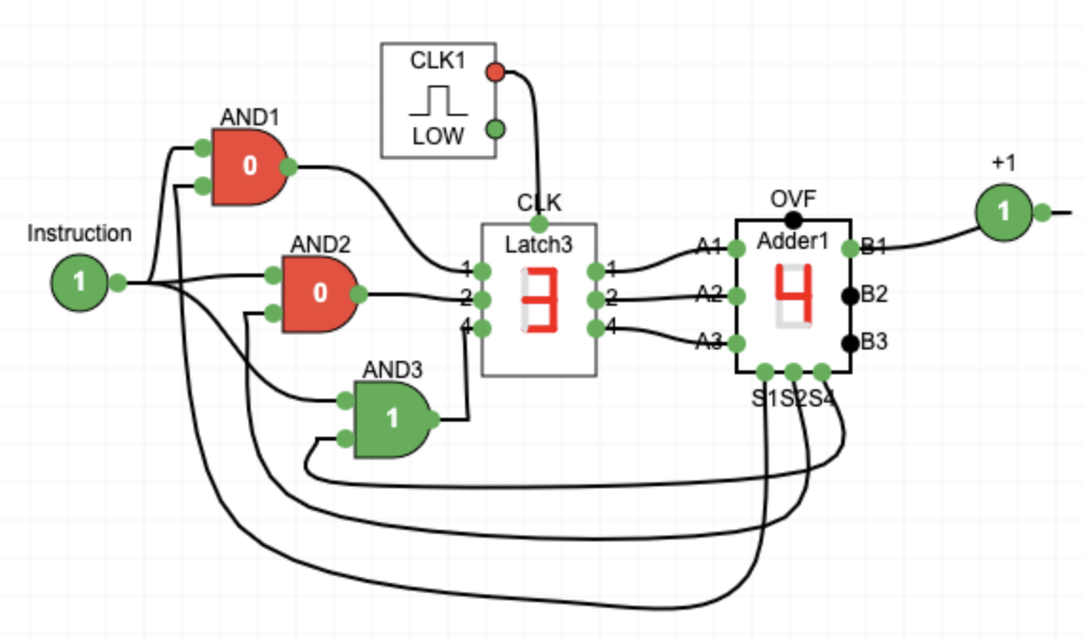
Review: What is missing?
The instructions are not being read from memory.
It is like there is a switch on the front of the computer and it chooses between the two instructions
We want a flexible sequence of many combinations of instruction sequences(a.k.a. Software)

Slide 4


What
Next?
Generic
Computer
Software
Input
and Output
Devices
Central
Processing
Unit
Secondary
Memory
11100010
11101000
Main
Memory
Python for Everybody
Chapter 1
Slide 19
Machine
Language
Notes:
This slide is a block diagram of a computer showing a central processing unit connected to main memory. Software is loaded into the main memory. The software can also interact with input / output devices and secondary memory for long-term storage.

Slide 5
Fetch-Decode-Execute-Cycle
CPU
ALU
Data
Registers
Program Counter (PC) Register – Address of the next machine code instruction
Current Instruction Register (CIR)
The decoder looks at the bits of the CIR and using gates activates the correct ALU Element and register
The Clock causes the logic when to compute and when to copy results back to the register
PC
CIR
Decoder
Instructions
Cache / Memory
https://en.wikipedia.org/wiki/Binary_decoder

Slide 6
Machine Language Instructions
As part of the documentation for a CPU, we are given the bit patterns of the machine code for each of its instructions
There is usually a symbolic language that translates to machine language (assembler)
Assembly | Opcode | Description
CLX | 11100010 | Clear X register (X = 0).
INX | 11101000 | Increment X register by 1
LDX #value | 10100010 | Load X register with immediate (constant) value
LDX $address | 10100110 | Load X register from zero-page memory address
STX $address | 10000110 | Store X register to zero-page memory address

Slide 7
Let's learn Base-16 (Hexadecimal)
Base 16 is easy to convert to bits and much less verbose than Base-2

Slide 8
Recall Base-2
Base–2 to Base-10 for numbers less than 8
A.k.a. 3-bit numbers
Base-10 | Base-2
0 | 0
1 | 1
2 | 10
3 | 11
4 | 100
5 | 101
6 | 110
7 | 111
4s 2s 1s
1 1 0 = 6

Slide 9
The first problem with Base-16
Base-10 | Base-2 | Base-16
0 | 0 | 0
1 | 1 | 1
2 | 10 | 2
3 | 11 | 3
4 | 100 | 4
5 | 101 | 5
6 | 110 | 6
7 | 111 | 7
8 | 1000 | 8
9 | 1001 | 9
10 | 1010 | ✊
11 | 1011 | ☝️
12 | 1100 | ✌️
13 | 1101 | 🤟
14 | 1110 | 🍀
15 | 1111 | 🖐
We only have 0-9 and we need to be able to represent 0-15 in a single base-16 digit
Thankfully we have emoji's
10 ✊
11 ☝️
12 ✌️
13 🤟 (also Rock on!)
14 🍀
15 🖐

Slide 10
AI suggested these emoji's
Base-10 | Base-2 | Base-16
0 | 0 | 0
1 | 1 | 1
2 | 10 | 2
3 | 11 | 3
4 | 100 | 4
5 | 101 | 5
6 | 110 | 6
7 | 111 | 7
8 | 1000 | 8
9 | 1001 | 9
10 | 1010 | 🔟
11 | 1011 | ⏸️
12 | 1100 | 🕛
13 | 1101 | 🕛
14 | 1110 | 🕑
15 | 1111 | 🕒
AI suggested emoji's
10 🔟
11 ⏸️
12 🕛
13 🕐 (1PM is 1300 hours)
14 🕑 (2PM is 1400 hours)
15 🕒 (3 PM is 1500 hours)
American Sign Language(ASL) uses one hand but requires motion
British Sign Language is different

Slide 11
No emojis in 1940 😭📅😭
Base-10 | Base-2 | Base-16
0 | 0 | 0
1 | 1 | 1
2 | 10 | 2
3 | 11 | 3
4 | 100 | 4
5 | 101 | 5
6 | 110 | 6
7 | 111 | 7
8 | 1000 | 8
9 | 1001 | 9
10 | 1010 | A
11 | 1011 | B
12 | 1100 | C
13 | 1101 | D
14 | 1110 | E
15 | 1111 | F
We only have 0-9 as numbers and we need to be able to represent 0-15 in a single base-16 digit
So we used A-F to represent 10-15 for base-16 numbers

Slide 12
Base-10 and Base-16 (Hexadecimal) numbers
Need a cheat sheet
Base-10
123₁₀ = 1 x 10² + 2 x 10¹ + 3 * 10⁰
= 1 x 100 + 2 * 10 + 3 * 1 = 123₁₀
Base-16
7B₁₆ = 7 * 16¹ + 11 * 16⁰ =
= 112 + 11 = 123₁₀
Base-10 | Base-16
10 | A
11 | B
12 | C
13 | D
14 | E
15 | F

Slide 13
Base-16 to/from Base-2
Base-10 | Base-2 | Base-16
0 | 0 | 0
1 | 1 | 1
2 | 10 | 2
3 | 11 | 3
4 | 100 | 4
5 | 101 | 5
6 | 110 | 6
7 | 111 | 7
8 | 1000 | 8
9 | 1001 | 9
10 | 1010 | A
11 | 1011 | B
12 | 1100 | C
13 | 1101 | D
14 | 1110 | E
15 | 1111 | F
Since 2 and 16 are even powers of 2, each Base-16 represents exactly four base-2 digits so we can convert digit by digit
7B ₁₆
0111 1011 ₂
A2 ₁₆
1010 0010 ₂
Hex is just more succinct Base-2

Slide 14
Keep it simple for now
Base-10 | Base-2 | Base-16
0 | 0 | 0
1 | 1 | 1
2 | 10 | 2
3 | 11 | 3
4 | 100 | 4
5 | 101 | 5
6 | 110 | 6
7 | 111 | 7
8 | 1000 | 8
9 | 1001 | 9
10 | 1010 | A
11 | 1011 | B
12 | 1100 | C
13 | 1101 | D
14 | 1110 | E
15 | 1111 | F
Go through base-10 if it helps
8s 4s 2s 1s
1 0 1 0 = 10₁₀ = A₁₆
1 0 0 0 = 8₁₀ = 8₁₆
1 1 1 1 = 15₁₀ = F₁₆

Slide 15
Chuck's not-so-quick Guide to Base-16
F₁₆ = 15₁₀ = 1111₂ (Easy one less than 16)
E₁₆ = 14₁₀ = 1110₂ (one less than 15)
A₁₆ = 10₁₀ = 1010₂ (8+2)
B₁₆ = 11₁₀ = 1010₂ (8+2+1)
C₁₆ = 😕 🧠 🤟 = 8+3 = 1011₂
D₁₆ = 😕 🤔 ⬆️ ⬇️ 🧠 📝 😠
AI: What is a good way to be able to do hex to base 2 conversions in your head?

Slide 16
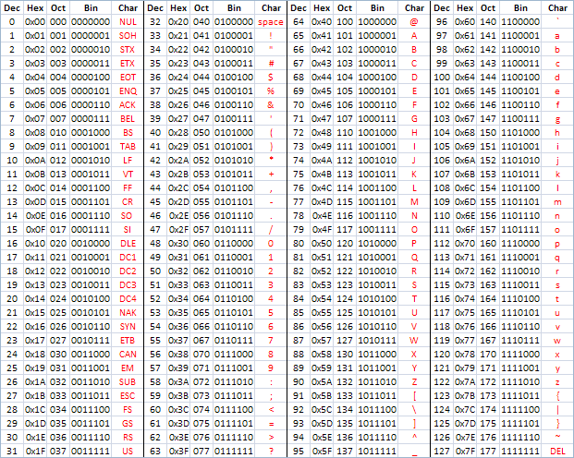
ASCII – 8 Bits
ASCII Characters are 8-bits and can be nicely represented with two hex digits (a.k.a. nibbles)
American Standard Code for Information Interchange
https://en.wikipedia.org/wiki/ASCII
http://www.catonmat.net/download/ascii-cheat-sheet.png
https://www.ca4e.com/tools/ascii/

Slide 17
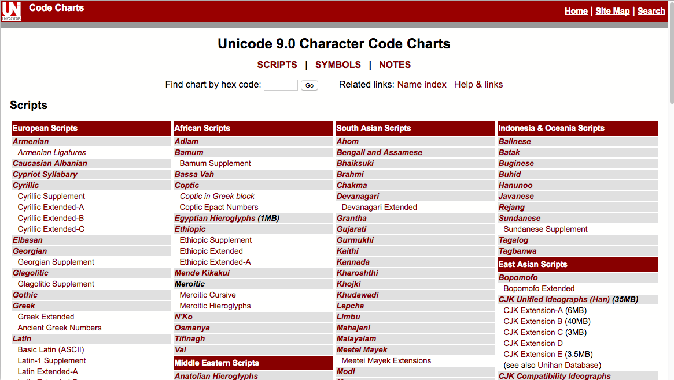
http://unicode.org/charts/

Slide 18
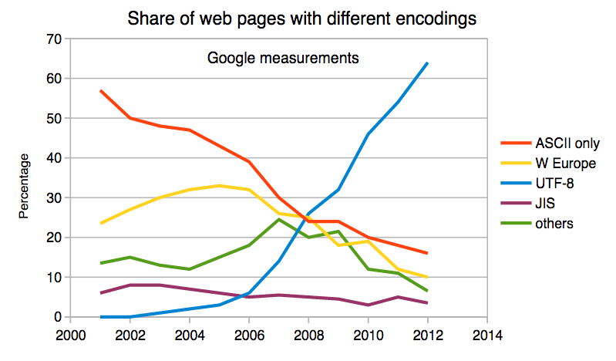
Multi-Byte Characters (a quick aside…)
To represent the wide range of characters computers must handle we represent characters with more than one byte
UTF-16 – Fixed length - Two bytes
UTF-32 – Fixed Length - Four Bytes
UTF-8 – 1-4 bytes
- Upwards compatible with ASCII
- Automatic detection between ASCII and UTF-8
- UTF-8 is recommended practice for encoding data to be exchanged between systems
https://en.wikipedia.org/wiki/UTF-8

Slide 19
The Essense of Programming
Hint: Machine code will both be simpler and a lot more complex. There is a reason we built languages like C and Python.

Slide 20
What is Programming? Python for Everybody
www.py4e.com

Slide 21
What
Next?
Generic
Computer
Software
Input
and Output
Devices
Central
Processing
Unit
Secondary
Memory
11100010
11101000
Main
Memory
Python for Everybody
Chapter 1
Slide 19
Machine
Language
Notes:
This slide is a block diagram of a computer showing a central processing unit connected to main memory. Software is loaded into the main memory. The software can also interact with input / output devices and secondary memory for long-term storage.

Slide 22
Program Steps or Program Flow
Like a recipe or installation instructions, a program is a sequence of steps to be done in order.
Some steps are conditional - they may be skipped.
Sometimes a step or group of steps is to be repeated.
Sometimes we store a set of steps to be used over and over as needed several places throughout the program

Slide 23
Sequential Steps
x = 2
Program:
x = 2
print(x)
x = x + 2
print(x)
Output:
2
4
print(x)
x = x + 2
print(x)
When a program is running, it flows from one step to the next. As programmers, we set up “paths” for the program to follow.

Slide 24
Conditional Steps
x = 5
x < 10 ?
Yes
Program:
x = 5
if x < 10:
print('Smaller')
if x > 20:
print('Bigger')
print('Finis')
print('Smaller')
No
Output:
Smaller
Finis
x > 20 ?
Yes
print('Bigger')
No
print('Finis')

Slide 25
Repeated Steps
n = 5
No
n > 0 ?
Yes
Output:
5
4
3
2
1
Blastoff!
Program:
n = 5
while n > 0 :
print(n)
n = n – 1
print('Blastoff!')
print(n)
n = n -1
print('Blastoff')
Loops (repeated steps) have iteration variables that change each time through a loop.

Slide 26
Variables
A variable is a named place in the memory where a programmer can store data and later retrieve the data using the variable “name”
Programmers get to choose the names of the variables
You can change the contents of a variable in a later statement
12.2
x = 12.2
y = 14
x = 100
x
100
14
y

Slide 27

The True Story of Python Assignment Statements
Charles Severance
www.dj4e.com

Slide 28
What *IS* a Python variable?
A Python variable is a symbolic name that is a pointer or reference to an object.
We can examine what a variable is ”pointing to” using the id() function in Python
>>> x = 42
>>> y = x
>>> print(id(x))
4311543376
>>> print(id(y))
4311543376
x
Object
int
42
y
https://realpython.com/python-variables/#object-references

Slide 29
From Python to C (Rosetta Stone) www.cc4e.com

Slide 30
Counted Loop
#include <stdio.h>
int main() {
int i;
for(i=0; i<5; i++) {
printf("%d\n",i);
}
}
for i in range(5) :
print(i)
0
1
2
3
4
cc_02_07.c

Slide 31
Read A File
#include <stdio.h>
int main() {
char line[1000];
FILE *hand;
hand = fopen("romeo.txt", "r");
while( fgets(line, 1000, hand) != NULL ) {
printf("%s", line);
}
}
hand = open('romeo.txt')
for line in hand:
print(line.strip())
But soft what light through yonder window breaks
It is the east and Juliet is the sun
Arise fair sun and kill the envious moon
Who is already sick and pale with grief
cc_02_06.c

Slide 32
Shouting
#include <stdio.h>
#include <string.h>
#include <ctype.h>
int main() {
char line[1000];
FILE *hand;
int i;
hand = fopen("romeo.txt", "r");
while( fgets(line, 1000, hand) != NULL )
for(i=0; i<strlen(line); i++)
putchar(toupper(line[i]));
}
hand = open('romeo.txt')
for line in hand:
print(line.strip().upper())
BUT SOFT WHAT LIGHT THROUGH YONDER WINDOW BREAKS
IT IS THE EAST AND JULIET IS THE SUN
ARISE FAIR SUN AND KILL THE ENVIOUS MOON
WHO IS ALREADY SICK AND PALE WITH GRIEF
cc_02_11.c

Slide 33
Summary of Basics of Programming
Patterns
Sequential
Conditional
Repeated
Variables
In Python and Java "point" to objects, that are created, reused, and garbage collected
In C and Machine Language, variables are *places* (i.e. like a little drawer with an address / label)

Slide 34
Lets Design a CPU
The CDC6504 is designed to be understandable

Slide 35
Why wouldn't we use a modern CPU?
Intel X86 – Introduced in 1978
Focused on Desktop computers
Includes AMD
ARM – Introduced in 1985
Focused on early cell phones
Core Instruction Set + Extensions
Modern CPUs are quite intricate because over time they added new instructions and kept the old ones for compatibility.

Slide 36
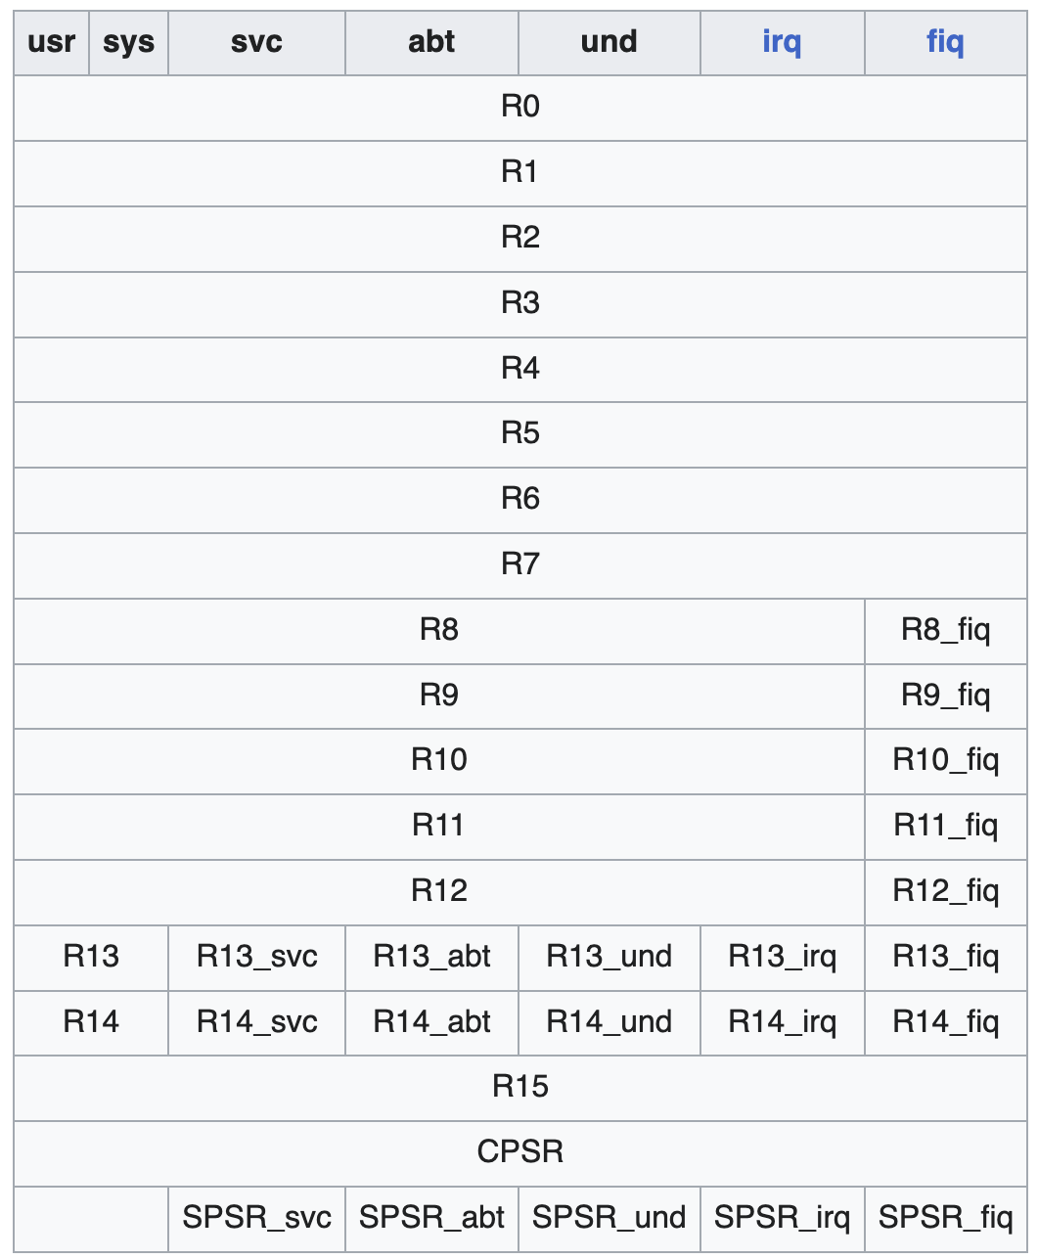
ARM Assembly
.global _start
_start:
MOV R0, #3 @ Load 3 into R0
MOV R1, #4 @ Load 4 into R1
ADD R0, R0, R1 @ R0 = R0 + R1 (3 + 4 = 7)
MOV R7, #1 @ syscall: exit
SWI 0 @ exit with code in R0 (7)

Slide 37
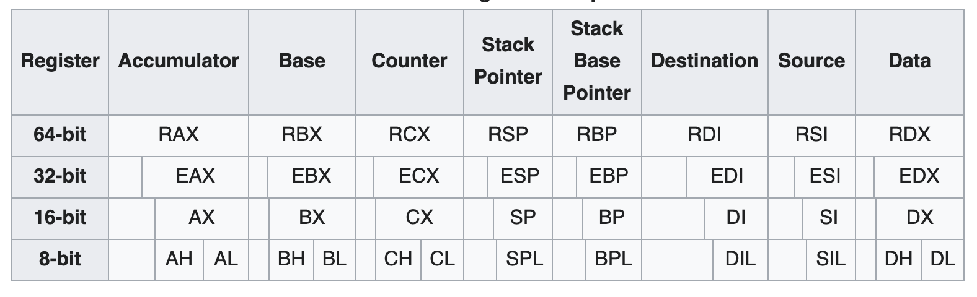
Intel X86 Assembly
global _start
_start:
mov eax, 3 ; Load 3 into eax
mov ebx, 4 ; Load 4 into ebx
add eax, ebx ; eax = eax + ebx (3 + 4 = 7)
mov ebx, eax ; exit code = sum (7)
mov eax, 1 ; syscall number for exit
int 0x80 ; make syscall

Slide 38
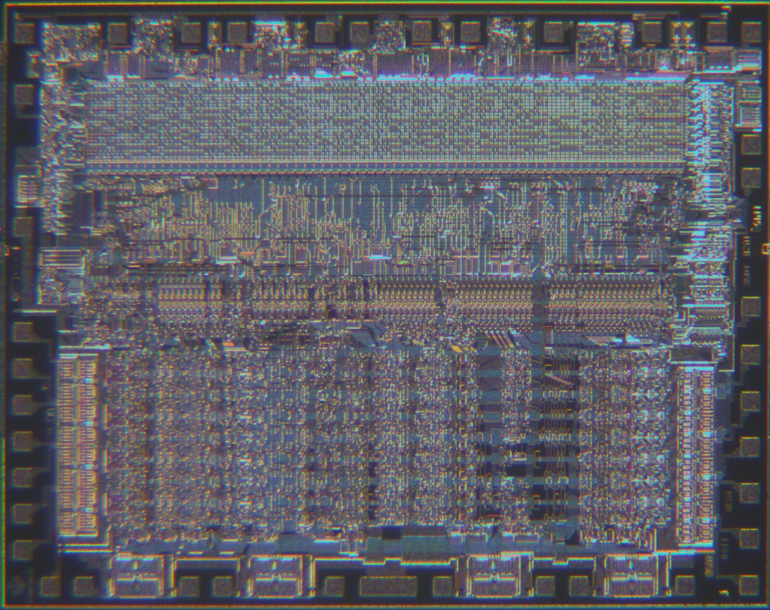
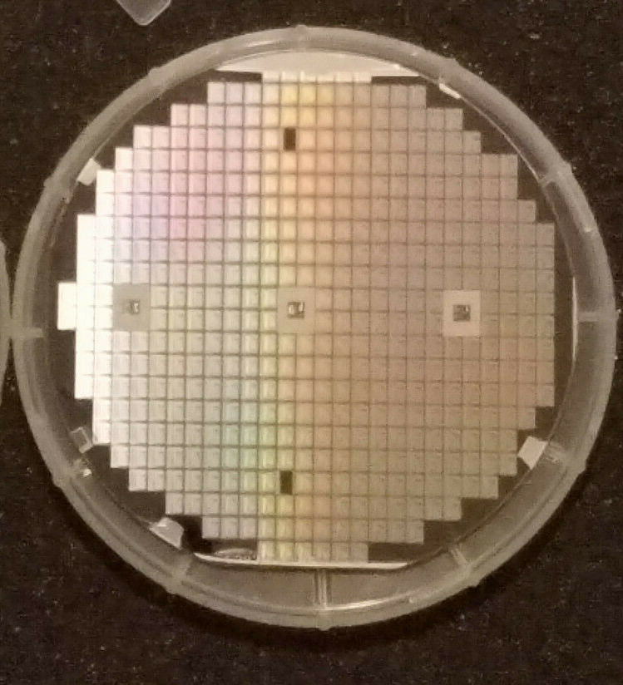
MOS Technology 6502
Launched in 1975 and cost $25
4,528 NMOS Transistors
Apple I, Apple II, Commodore PET, Commodore VIC-20, Commodore 64 (6510), Atari 2600, Atari 400, Atari 800, Atari XL series, Atari XE series, BBC Micro, Acorn Atom, Acorn Electron, Nintendo NES (2A03), Oric-1, Oric Atmos, Philips P2000, Ohio Scientific Challenger 1P, KIM-1 …
https://en.wikipedia.org/wiki/MOS_Technology_6502

Slide 39
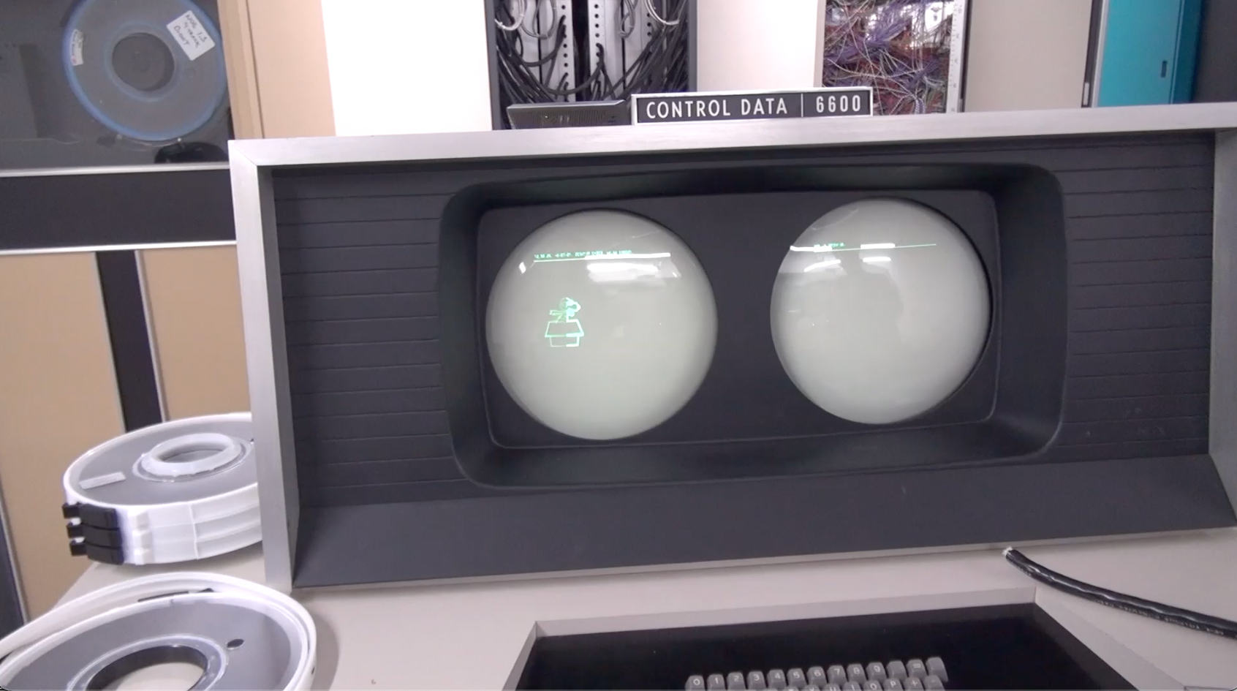
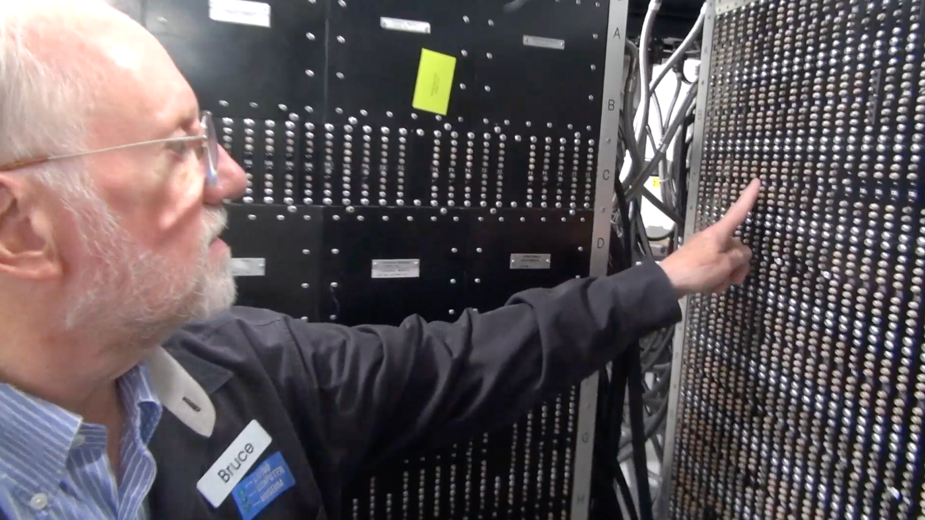
CDC 6504 – Named for the CDC 6500
Control Data Corporation
Mid 1960’s – mid-1970’s
Dr. Chuck’s first computer
FORTRAN
Assembly Language
https://en.wikipedia.org/wiki/CDC_6000_series#Central_processor

Slide 40
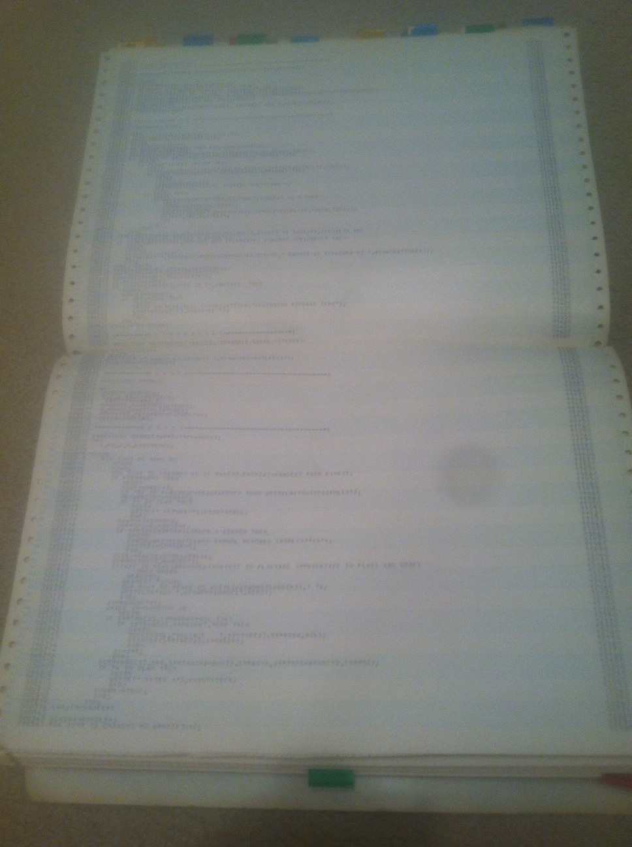
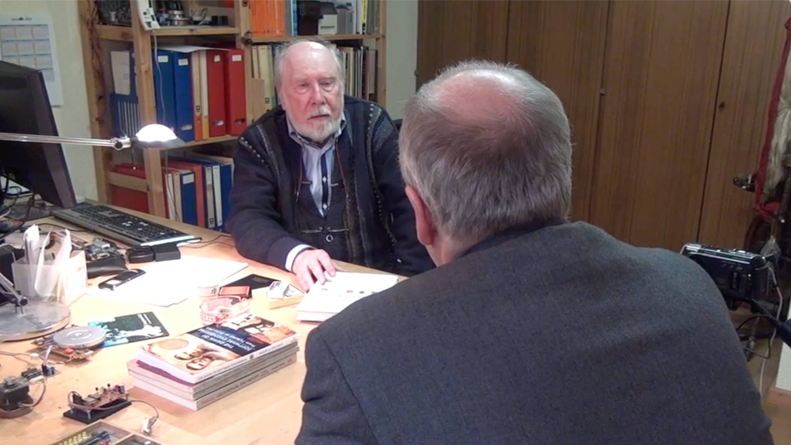
CDC 6504 – Named for CDC 6500
Control Data Corporation
Mid 1960’s – mid-1970’s
Dr. Chuck’s first computer
FORTRAN
Assembly Language
Pascal
https://en.wikipedia.org/wiki/CDC_6000_series#Central_processor

Slide 41
The CDC6504 Architecture

Slide 42
CDC6504 Architecture
PC
Z
N
ACC
X
Y
0x00
0
0
0x00
0x00
0x00
PC – Program Counter
ACC - Accumulator
Z – Was the last ACC result zero?
N – Was the last ACC result negative?
X and Y – Index registers
Instruction memory shown in base-2 for easy decoding
Data memory shown in hex – will usually contain ASCII
What
Next?
Instruction Memory
Data Memory
0x00
11100010
0x00
0x00
0x01
11101000
0x01
0x00
0x02
11101000
0x02
0x00
0x03
00000000
0x03
0x00
0x04
00000000
0x04
0x00
0x05
00000000
0x05
0x00

Slide 43
Programming the CDC6504
https://www.ca4e.com/tools/cdc6504/documentation.html
Assembly language is easier to read and translates directly to binary machine language
Assembly language also has labels, so we don't need to hand-compute the hex value of data or instruction address locations
Assembly | Opcode | Description
CLX | 11100010 | Clear X register (X = 0).
INX | 11101000 | Increment X register by 1
LDX #value | 10100010 | Load X register with immediate (constant) value
LDX $address | 10100110 | Load X register from zero-page memory address
STX $address | 10000110 | Store X register to zero-page memory address

Slide 44
Our first Program
PC
Z
N
ACC
X
Y
0x00
0
0
0x00
0x00
0x00
0x00
11100010
CLX ; Clear X register
INX ; Increment X
INX ; Increment X again
BRK
0x00
0x00
0x01
11101000
0x01
0x00
0x02
11101000
0x02
0x00
0x03
00000000
0x03
0x00
0x04
00000000
0x04
0x00
0x05
00000000
0x05
0x00
0x06
00000000
0x06
0x00

Slide 45
Our first Program
PC
Z
N
ACC
X
Y
0x00
0
0
0x00
0x00
0x00
0x00
11100010
CLX ; Clear X register
INX ; Increment X
INX ; Increment X again
BRK
0x00
0x00
0x01
11101000
0x01
0x00
0x02
11101000
0x02
0x00
0x03
00000000
0x03
0x00
0x04
00000000
0x04
0x00
0x05
00000000
0x05
0x00
0x06
00000000
0x06
0x00

Slide 46
Our first Program
PC
Z
N
ACC
X
Y
0x01
0
0
0x00
0x01
0x00
0x00
11100010
CLX ; Clear X register
INX ; Increment X
INX ; Increment X again
BRK
0x00
0x00
0x01
11101000
0x01
0x00
0x02
11101000
0x02
0x00
0x03
00000000
0x03
0x00
0x04
00000000
0x04
0x00
0x05
00000000
0x05
0x00
0x06
00000000
0x06
0x00

Slide 47
Our first Program
PC
Z
N
ACC
X
Y
0x02
0
0
0x00
0x02
0x00
0x00
11100010
CLX ; Clear X register
INX ; Increment X
INX ; Increment X again
BRK
0x00
0x00
0x01
11101000
0x01
0x00
0x02
11101000
0x02
0x00
0x03
00000000
0x03
0x00
0x04
00000000
0x04
0x00
0x05
00000000
0x05
0x00
0x06
00000000
0x06
0x00

Slide 48
Our first Program
PC
Z
N
ACC
X
Y
0x03
0
0
0x00
0x02
0x00
0x00
11100010
CLX ; Clear X register
INX ; Increment X
INX ; Increment X again
BRK
0x00
0x00
0x01
11101000
0x01
0x00
0x02
11101000
0x02
0x00
0x03
00000000
0x03
0x00
0x04
00000000
0x04
0x00
0x05
00000000
0x05
0x00
0x06
00000000
0x06
0x00

Slide 49
Our CPU from Logic, Gates, Transistors
There is a lot of overlap between the CDC6504 and our two instruction CPU….

Slide 50
Our CPU from Logic, Gates, Transistors
Increment
Instruction
Our CPU implements two instructions
Zero Register
Increment Register
There is no program counter because there is no instruction memory
But….
Decode
Logic
Register

Slide 51
Looking closer
These two instructions are the equivalent to the zero (clear the latch) and one (increment the latch) from our hand-built CPU
The 6502 has 8-bit registers
11100010
CLX ; Clear X register
INX ; Increment X
11101000

Slide 52
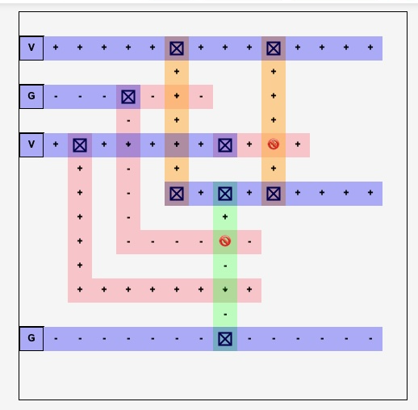
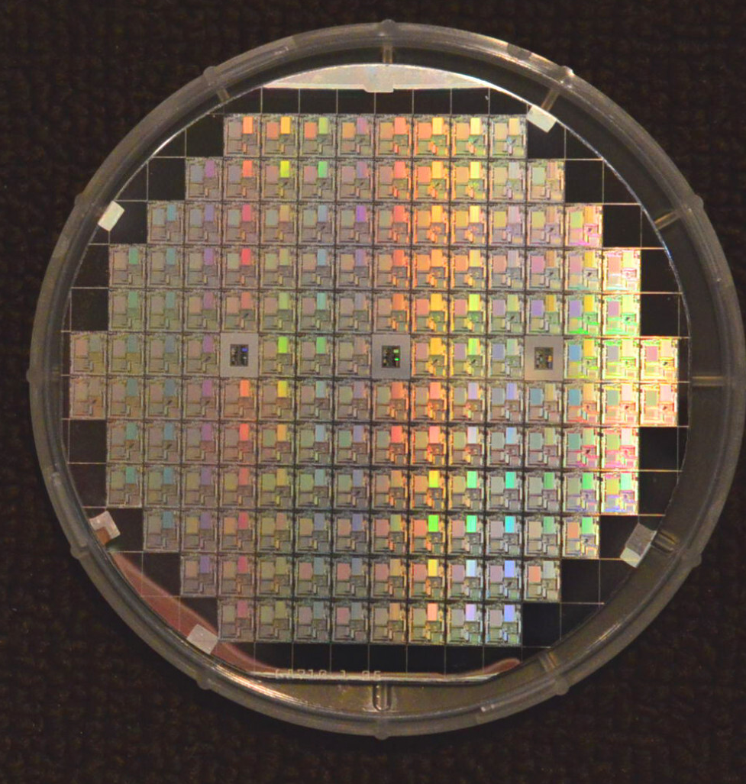
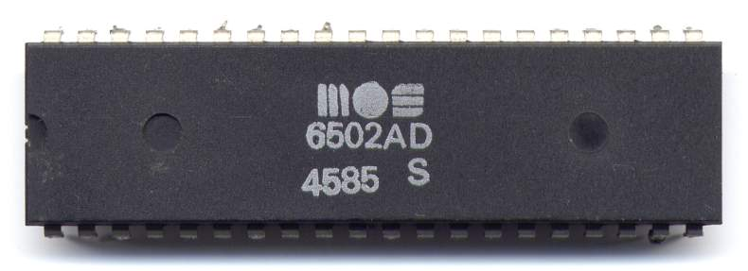
If you had time…
With what you know and and better design tools you could design a CDC6504
Logic
Memory
VLSI layout
Manufacture

Slide 53
CDC6504 Machine Language
https://www.ca4e.com/cdc6504/documentation.html

Slide 54
Index Instructions (8-bit)
https://www.ca4e.com/tools/cdc6504/documentation.html
The X and Y registers are often used to control counted loops or to be an offset within an array.
Assembly | Opcode | Description
CLX | 11100010 | Clear X register (X = 0). Sets Z flag to 1, N flag to 0.
CLY | 11000010 | Clear Y register (Y = 0). Sets Z flag to 1, N flag to 0s.
INX | 11101000 | Increment X register by 1
INY | 11001000 | Increment Y register by 1
DEX | 11001010 | Decrement X register by 1
DEY | 10001000 | Decrement Y register by 1

Slide 55
16-Bit Instructions
https://www.ca4e.com/tools/cdc6504/documentation.html
The byte immediately following the instruction can be a constant value or data memory address
Assembly | Opcode | Description
LDA #value | 10101001 | Load accumulator with immediate value (0-255, 0x00-0xFF, or 'A')
LDA $address | 10100101 | Load accumulator using immediate value as memory address
0x00
10000101
LDA #'*'
0x02
10100101
LDA $02
0x01
00101010
(the 42)
0x03
00000010
(the address 2)

Slide 56
Load / Store Instructions
https://www.ca4e.com/tools/cdc6504/documentation.html
Assembly | Opcode | Description
LDA #value | 10101001 | Load accumulator with immediate value (ACC = value)
LDA $address | 10100101 | Load accumulator from zero-page memory address (ACC = memory[address])
LDX #value | 10100010 | Load X register with immediate value (X = value)
LDX $address | 10100110 | Load X register from zero-page memory address (X = memory[address])
LDY #value | 10100000 | Load Y register with immediate value (Y = value)
STA $address | 10000101 | Store accumulator to zero-page memory address (memory[address] = ACC)
STX $address | 10000110 | Store X register to zero-page memory address (memory[address] = X)
STY $address | 10000100 | Store Y register to zero-page memory address (memory[address] = Y)

Slide 57
Arithmetic Instructions
https://www.ca4e.com/tools/cdc6504/documentation.html
Adding and subtraction and getting back a result is ACC only
Assembly | Opcode | Description
ADC #value | 01101001 | Add (immediate): ACC = ACC + value
ADC $address | 01100101 | Add (from memory): ACC = ACC + memory[address]
SBC #value | 11101001 | Subtract (immediate): ACC = ACC - value
SBC $address | 11100101 | Subtract (from memory): ACC = ACC - memory[address]

Slide 58
Comparison Instructions
https://www.ca4e.com/tools/cdc6504/documentation.html
Comparison is like doing a subtraction, setting Z and N and then discarding the result of the subtraction.
Assembly | Opcode | Description
CMP #value | 11001001 | Compare accumulator with immediate value, sets Z, N flags
CMP $address | 11000101 | Compare accumulator with memory[address], sets Z, N flags
CPX #value | 11100000 | Compare X register with immediate value, sets Z, N flags
CPX $address | 11100100 | Compare X register with memory[address], sets Z, N flags
CPY #value | 11000000 | Compare Y register with immediate value, sets Z, N flags
CPY $address | 11000100 | Compare Y register with memory[address], sets Z, N flags

Slide 59
There is no IF statement in Machine Code
https://www.ca4e.com/tools/cdc6504/documentation.html
Every instruction that changes a register (and the compare instructions) sets the result flags
Z = 1 if the result is zero, 0 if the result is no zero
N = 1 if the result is negative and 0 if the result is positive
The CMP instruction is like subtraction – it sets Z and N but ignores the result value of the subtraction
Result | Z | N
0 | 1 | 0
positive | 0 | 1
negative | 0 | 0

Slide 60
There is no IF statement in Machine Code
https://www.ca4e.com/tools/cdc6504/documentation.html
The closest we have to an IF is a CMP + conditional jump
Assembly | Opcode | Description
BEQ $address | 11110000 | Branch if equal (Z flag set)
BNE $address | 11010000 | Branch if not equal (Z flag clear)
BMI $address | 00110000 | Branch if minus (N flag set)
BPL $address | 00010000 | Branch if plus (N flag clear)
LDA #'p' ; ASCII value for 'p'
CMP #'a' ; ASCII value for 'a'
BMI $08 ; Branch if minus (less than)
SBC #0x20 ; convert to uppercase
BRK ; This is at 0x08
if acc < 'a' : goto skip
acc = acc – 0x20
skip: BRK

Slide 61
0x00
10000110
LDA #'p'
ACC = 'p'
0x01
01110000
(the 'p')
0x02
10001110
CMP #'a'
ACC ? 'a'
0x03
01100001
(the 'a')
Yes
0x04
10100001
BMI $08
N?
0x05
00001000
(the 0x08)
No
0x06
10000101
SBC #0x20
ACC = ACC–0x20
0x07
00101010
(the 0x20)
0x08
00000000
BRK
Halt
Notes:
This is a simple program to check if a character ('p') is already upper case. If it is not upper case, we subtract 0x20 from the ASCII value to convert it to upper case. At the end of the program, X2 contains the upper-case value whether the initial value was an upper- or lower-case letter. The result in X2 is 'P' (upper-case)

Slide 62
Assembly gives us labels
0x00
10000110
LDA #'p'
0x01
01110000
(the 'p')
No need to compute instruction addresses by hand
10001110
0x02
CMP #'a'
0x03
01100001
(the 'a')
0x04
10100001
BMI 0x08
LDA #'p'
CMP #'a'
BMI skip
SBC #0x20
skip:
BRK
0x05
00001000
(the 0x08)
0x06
10000101
SBC #0x20
0x07
00101010
(the 0x20)
0x08
00000000
BRK

Slide 63
Jumps are far simpler than "if logic"
You can think of the unconditional Jump as a SET of the Program Counter (PC) register
A conditional jump is a conditional set of the PC register
Assembly | Opcode | Description
JMP $address | 01001100 | Unconditional jump to absolute address (zero-page)
BEQ $address | 11110000 | Branch if equal (Z flag set)
BNE $address | 11010000 | Branch if not equal (Z flag clear)
BMI $address | 00110000 | Branch if minus (N flag set)
BPL $address | 00010000 | Branch if plus (N flag clear)

Slide 64
There is no "for" or "while" in machine language
X = 0
X ? 5
Yes
Z ?
CLX ; Clear X register
loop:
CPX #5 ; Compare X to 5
BEQ end ; Branch if equal (Z flag set)
INX ; Increment X
JMP loop ; Jump to loop
end:
BRK ; Halt
No
X = X + 1
JMP loop
BRK

Slide 65
https://www.ca4e.com/tools/cdc6504/documentation.html
Assembly | Opcode | Description
CLX | 11100010 | Clear X register (X = 0). Sets Z flag to 1, N flag to 0.
INX | 11101000 | Increment X register by 1
LDA #value | 10101001 | Load accumulator with immediate value (ACC = value)
LDA $address | 10100101 | Load accumulator (ACC = memory[address])
STA $address | 10000101 | Store accumulator (memory[address] = ACC)
ADC #value | 01101001 | Add (immediate): ACC = ACC + value
SBC $address | 11100101 | Subtract (from memory): ACC = ACC - memory[address]
CMP #value | 11001001 | Compare accumulator with immediate value, sets Z, N flags
JMP $address | 01001100 | Unconditional jump to absolute address (zero-page)
BEQ $address | 11110000 | Branch if equal (Z flag set)
BMI $address | 00110000 | Branch if minus (N flag set)
BRK | 00000000 | Break/Halt - Stop program execution

Slide 66
CDC 6504 – Assembly Language
https://www.ca4e.com/cdc6504/documentation.html

Slide 67
Add 5 + 15 and Store
LDA #10 ; Load 10 into accumulator
ADC #5 ; Add 5 (result = 15)
STA $00 ; Store result to memory[0]
BRK

Slide 68
Conditional convert to upper case
LDA #'p' ; 0x70 is the ASCII value for 'p'
CMP #'a' ; 0x61 is the ASCII value for 'a'
BMI skip ; Branch if minus (less than)
SBC #0x20 ; Subtract 0x20 to convert to uppercase
skip:
BRK

Slide 69
Print Hello
LDA #'H' ; Load 'H' into accumulator
STA $00
LDA #'e' ; Load 'e' into accumulator
STA $01
LDA #'l' ; Load 'l' into accumulator
STA $02
STA $03 ; Store 'l' again
LDA #'o' ; Load 'o' into accumulator
STA $04
BRK

Slide 70
Count to Five
CLX ; Clear X register
loop:
CPX #5 ; Compare X register to 5 (simpler than TXA/CMP)
BEQ end ; Branch if equal (Z flag set)
INX ; Increment X
JMP loop ; Jump to loop
end:
BRK ; Halt

Slide 71
Data Directive – Assembly Only
Assembly | Description
DATA 'string' | Pre-populates data memory (not instruction memory) with a null-terminated string. Data is loaded starting at memory address 0.
DATA 0x00 0x0A ... | Pre-populates data memory (not instruction memory) with a space-separated list of hexadecimal values. Data is loaded starting at memory address 0.

Slide 72
Summary
MOV X3, A3 ; Copy a register to another
SET X3, 42 ; Set a register to an 8-bit value
INC A1 ; Add 1 to a register
DEC X3 ; Subtract 1 from a register
ADD X1, 42 ; Add a constant to a register
SUB X3, 42 ; Subtract a constant from a register
JP lab ; Jump to a label
CMP X3, 42 ; Compare a register to a constant and set comparison status
JE 0x12 ; Jump to the address if CMP was equal
JG 0x12 ; Jump to the address if CMP was >
JL 0x12 ; Jump to the address if CMP was <
lab:
HALT ; Stop Execution
DATA 'Hello world'

Slide 73
CDC6504 Emulator in JavaScript
// 5-bit patterns (bits 7-3)
else if ((instruction >> 3) === 0x08) { // 01000xxx - ZERO
const register = instruction & 0x07;
const regName = this.getRegisterName(register);
this.cpu[regName] = 0;
// CDC 6500 load/store architecture:
if (regName === 'a0') {
this.cpu.x0 = this.cpu.memory[this.cpu.a0];
} else if (regName === 'a1') {
this.cpu.x1 = this.cpu.memory[this.cpu.a1];
} else if (regName === 'a2') {
this.cpu.memory[this.cpu.a2] = this.cpu.x2;
} else if (regName === 'a3') {
this.cpu.memory[this.cpu.a3] = this.cpu.x3;
}
pcIncrement = 1;
}

Slide 74
Emulators for Fun

Slide 75
Building Emulators for Historical CPUs
It is not all that difficult to build an emulator for an older (simpler) CPU
Modern processors on our phones and computers are so fast that JavaScript in a browser can emulate historical machine code faster than the original hardware
The computer / phone / browser graphics are also far better
And it can be great fun

Slide 76
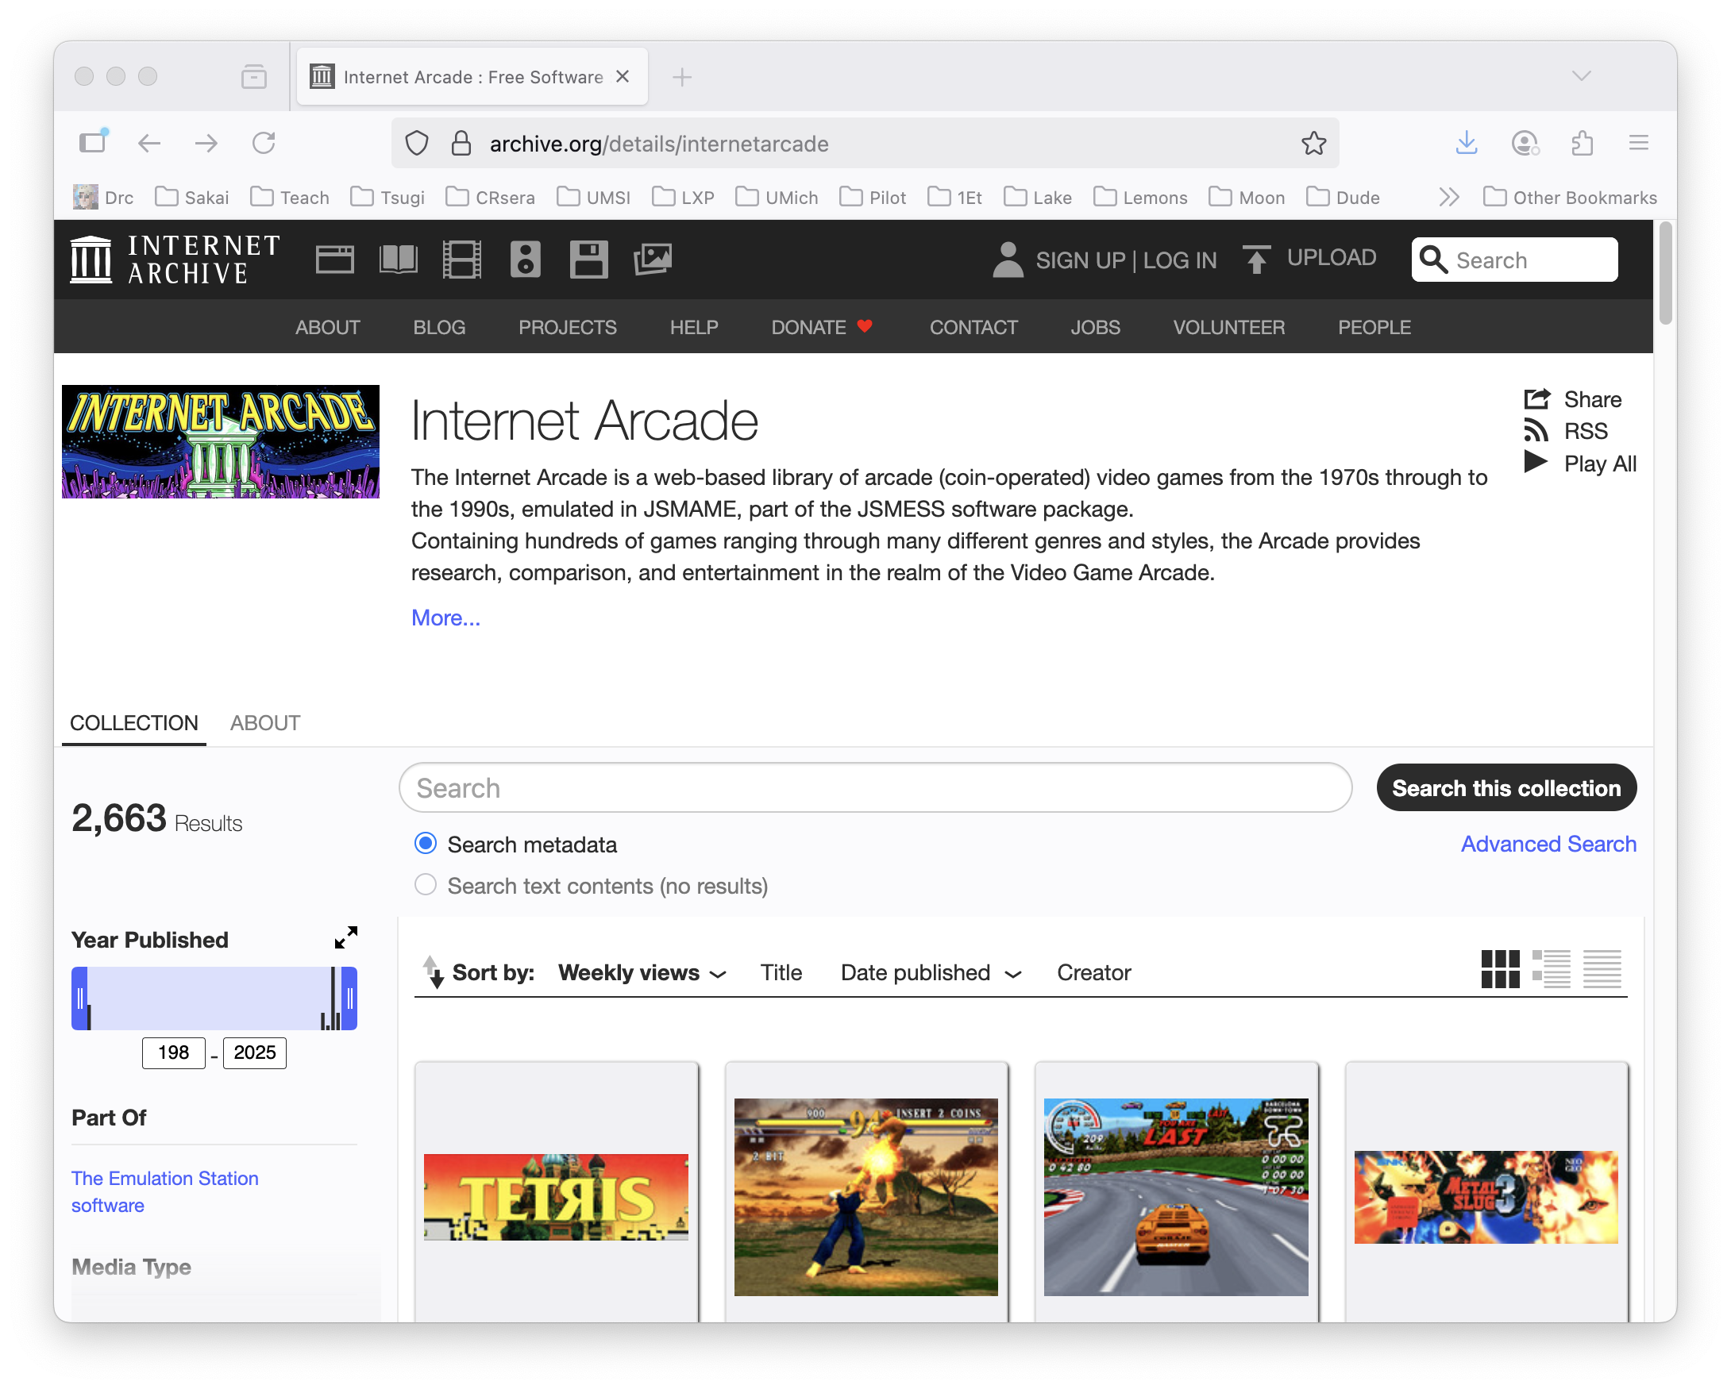
Archive.org: Internet Arcade

Slide 77
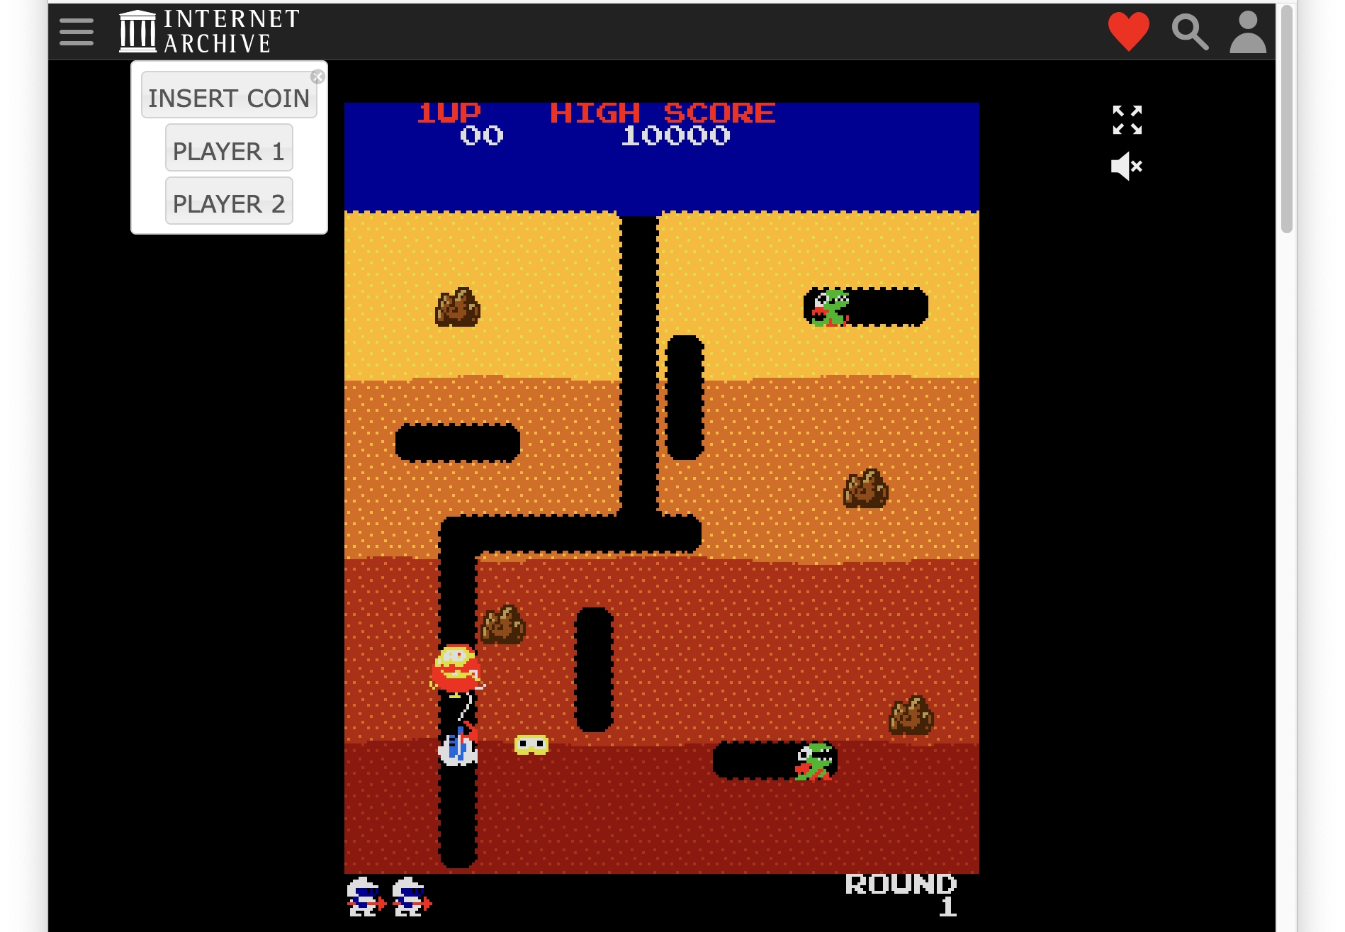
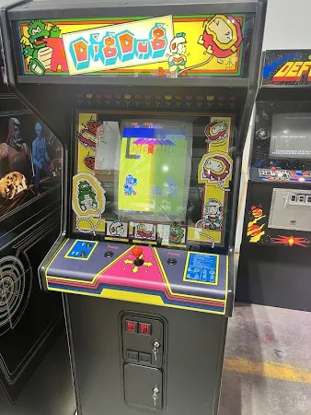
Game: Dig Dug

Slide 78
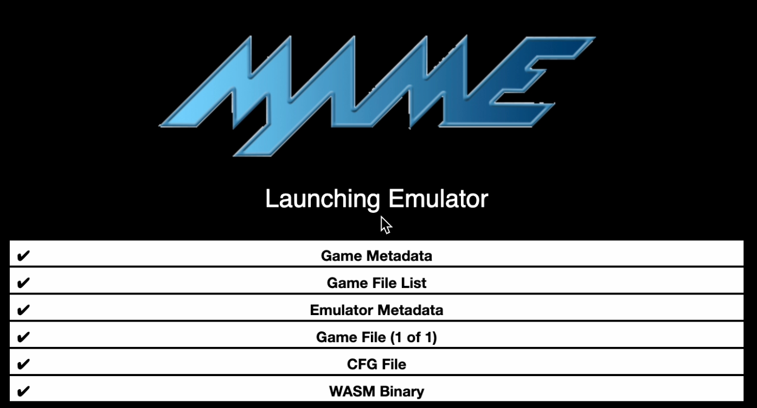
Dig Dug Startup – JSMAME Emulator

Slide 79
CPU Evolution
At this point, you might know enough to build the Apple I

Slide 80
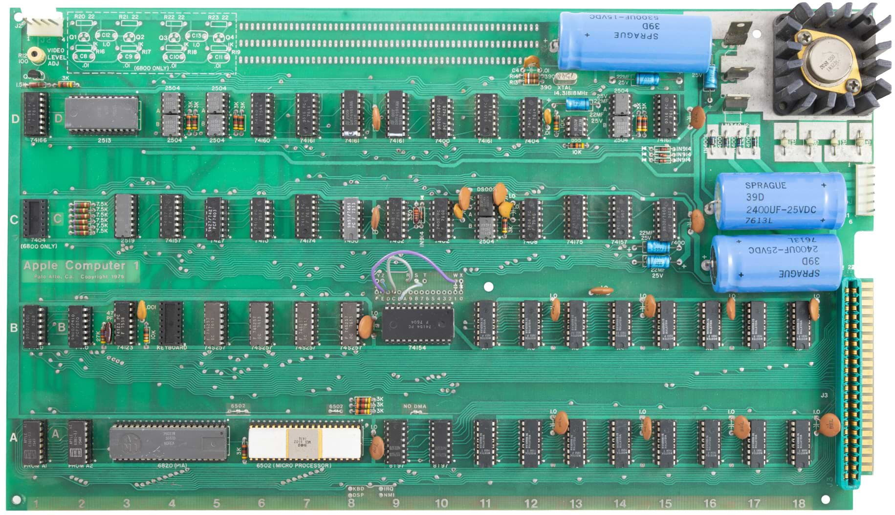

Slide 81
Apple Computer Processors over time
MOS 6502 – Apple I / Apple II – 1977 - 1993
Motorola MC68000 – Macintosh 1984-1994
IBM PowerPC – Macintosh 1994 – 2006
Intel x86 – Macintosh (2006-2020)
Samsung ARM – iPhone (2007-2009)
Apple ARM – iPhone (2010-Present)
Apple ARM – Macintosh (2020-Present)
Apple currently redesigns their CPUs based on workload over time – Image Processing / Audio / Video / Gaming / Artificial Intelligence

Slide 82
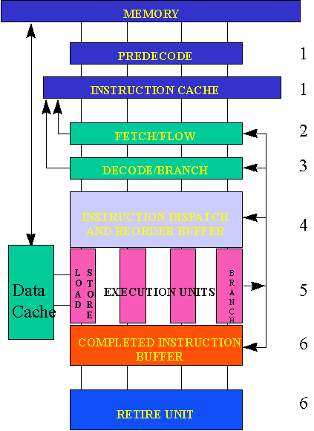
Reading: Post-Risc Architecture
https://cse.msu.edu/~enbody/postrisc/postrisc2.htm

Slide 83
WASM – Web Assembly
There is a machine language emulator built into browsers called Web Assembly
For a wide range of software, compiling to WASM and running in JavaScript is enough
WASM is a different syntax than most Assembly languages – but it still compiles to a binary-machine code
C Programming for Everybody (www.cc4e.com) C Playground compiles C to WASM and then runs the WASM in the user's browser

Slide 84
WASM Hello World
;; Hello World WASM Example
(module
(import "console" "log" (func $log (param i32 i32)))
(memory 1)
(data (i32.const 0) "Hello, World!")
(func $main (result i32)
(call $log (i32.const 0) (i32.const 13))
(i32.const 42)
)
(export "main" (func $main))
)
00000000: 00 61 73 6d 01 00 00 00 01 0a 02 60 02 7f 7f 00 |.asm.......`....|
00000010: 60 00 01 7f 02 0f 01 07 63 6f 6e 73 6f 6c 65 03 |`.......console.|
00000020: 6c 6f 67 00 00 03 02 01 01 05 03 01 00 01 07 11 |log.............|
00000030: 02 06 6d 65 6d 6f 72 79 02 00 04 6d 61 69 6e 00 |..memory...main.|
00000040: 01 0a 0c 01 0a 00 41 00 41 0d 10 00 41 2a 0b 0b |......A.A...A*..|
00000050: 13 01 00 41 00 0b 0d 48 65 6c 6c 6f 2c 20 57 6f |...A...Hello, Wo|
00000060: 72 6c 64 21 |rld!|

Slide 85
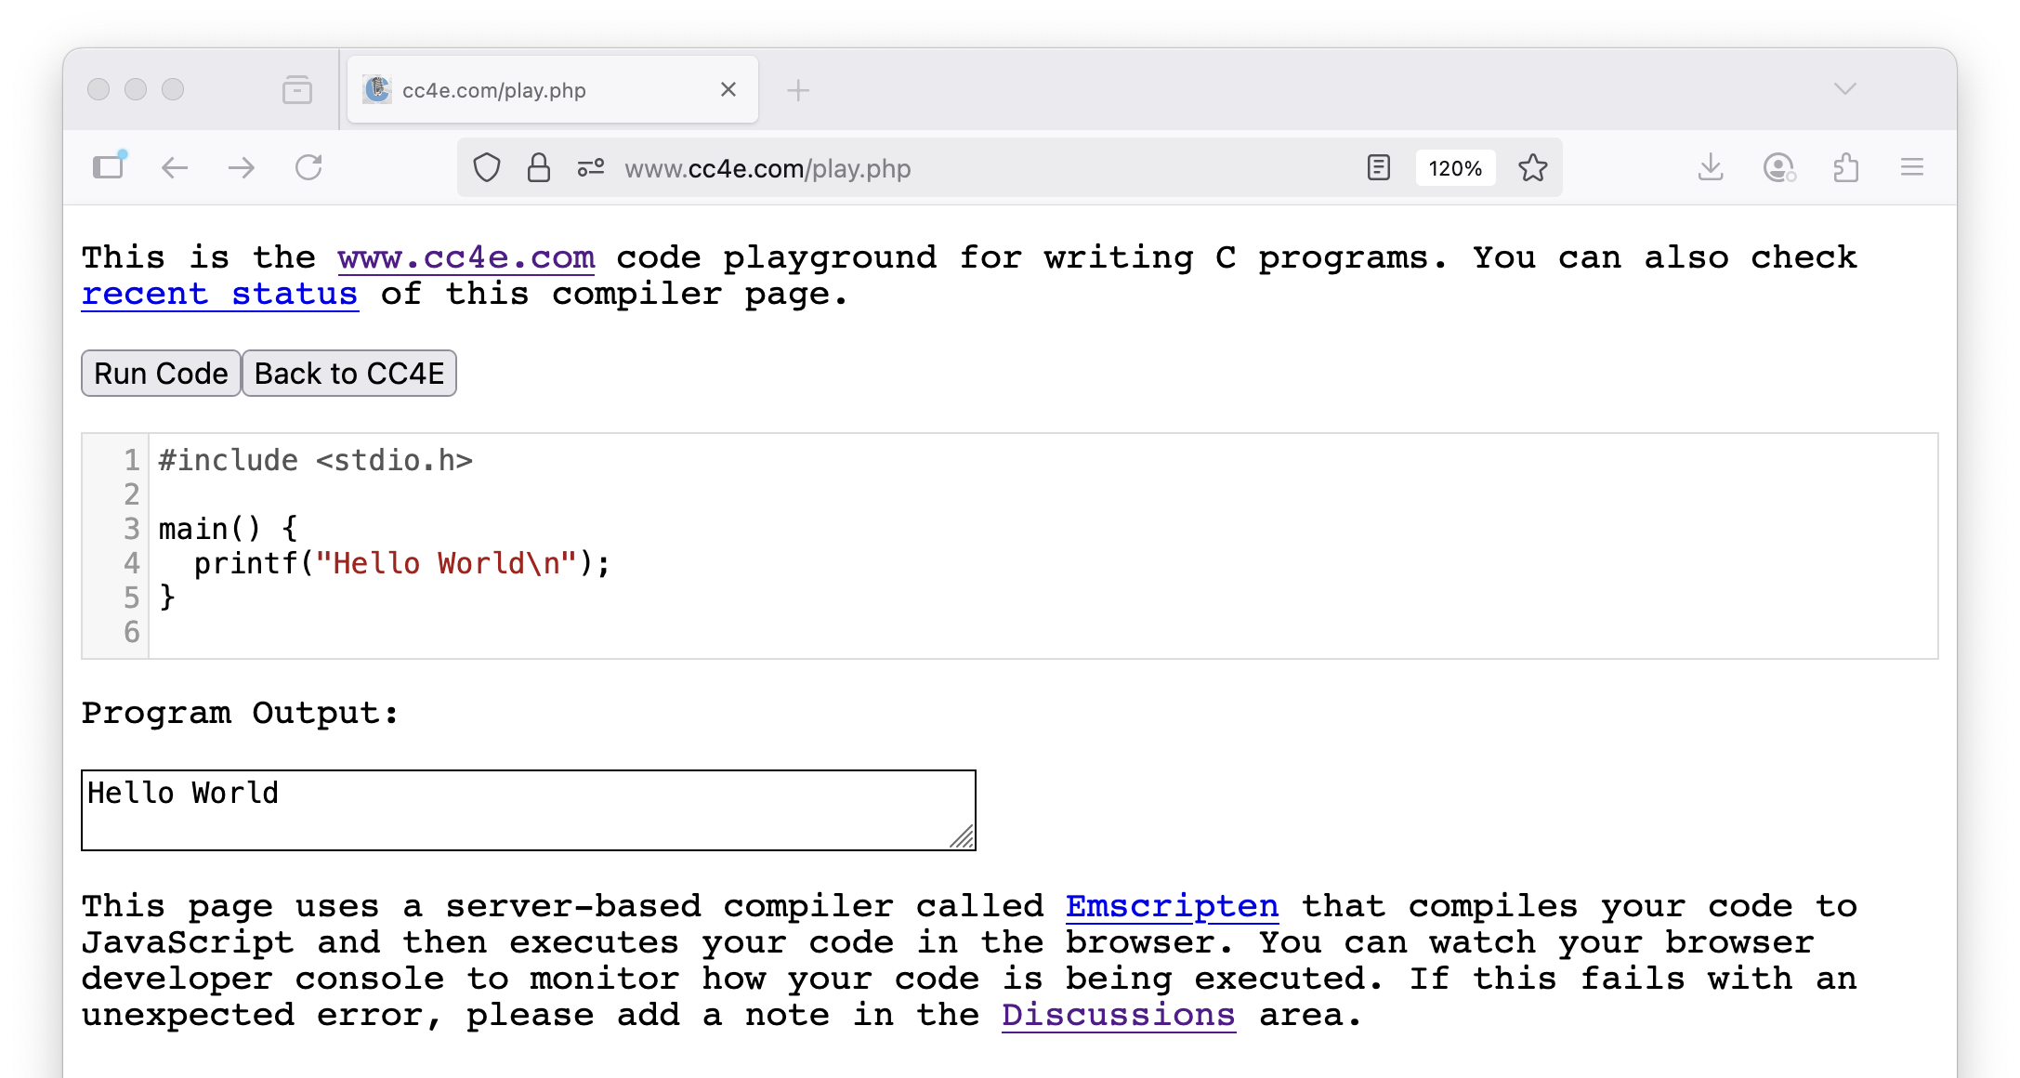

Slide 86
Summary
Fetch-Decode-Execute (a.k.a. Fetch-Execute-Cycle)
Look at the Intel x86 and ARM processor families
Explored the CDC6504 architecture, instruction set, assembly and machine languages
Explored an increasing use of in-browser emulators for games and other applications
Looked at CPU Evolution over time
Looked forward at Web Assembly (WASM)

Slide 87
Acknowledgements / Contributions
These slides are Copyright 2025- Charles R. Severance (online.dr-chuck.com) as part of www.ca4e.com and made available under a Creative Commons Attribution 4.0 License. Please maintain this last slide in all copies of the document to comply with the attribution requirements of the license. If you make a change, feel free to add your name and organization to the list of contributors on this page as you republish the materials.
Initial Development: Charles Severance, University of Michigan School of Information
Insert new Contributors and Translators here including names and dates
Continue new Contributors and Translators here

